Slide 1
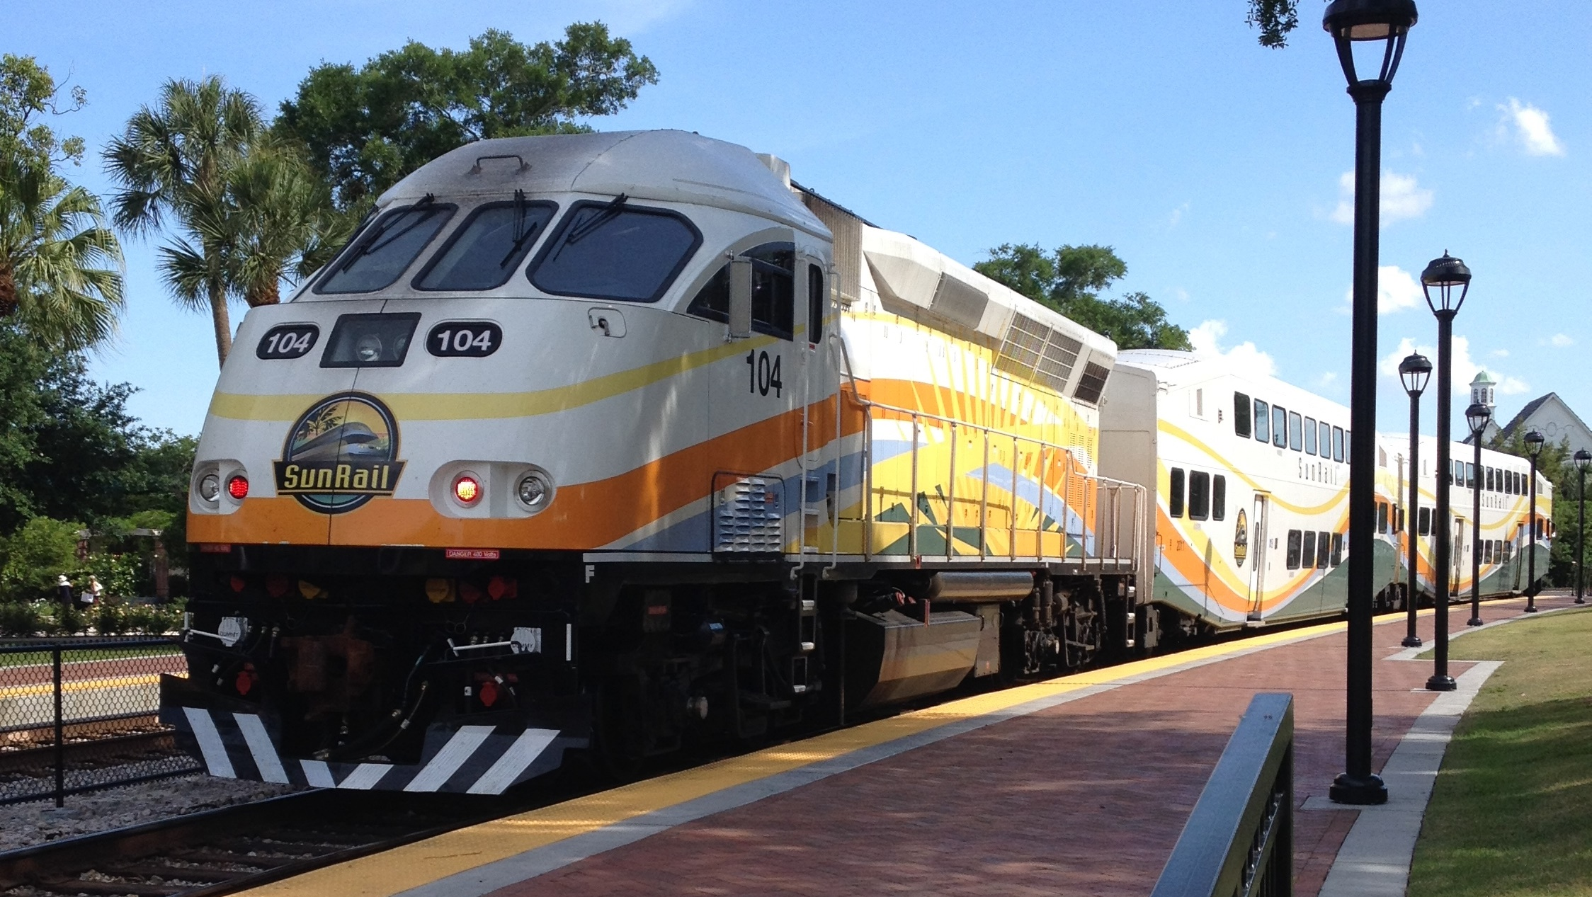

Sunshine Corridor

Slide 2
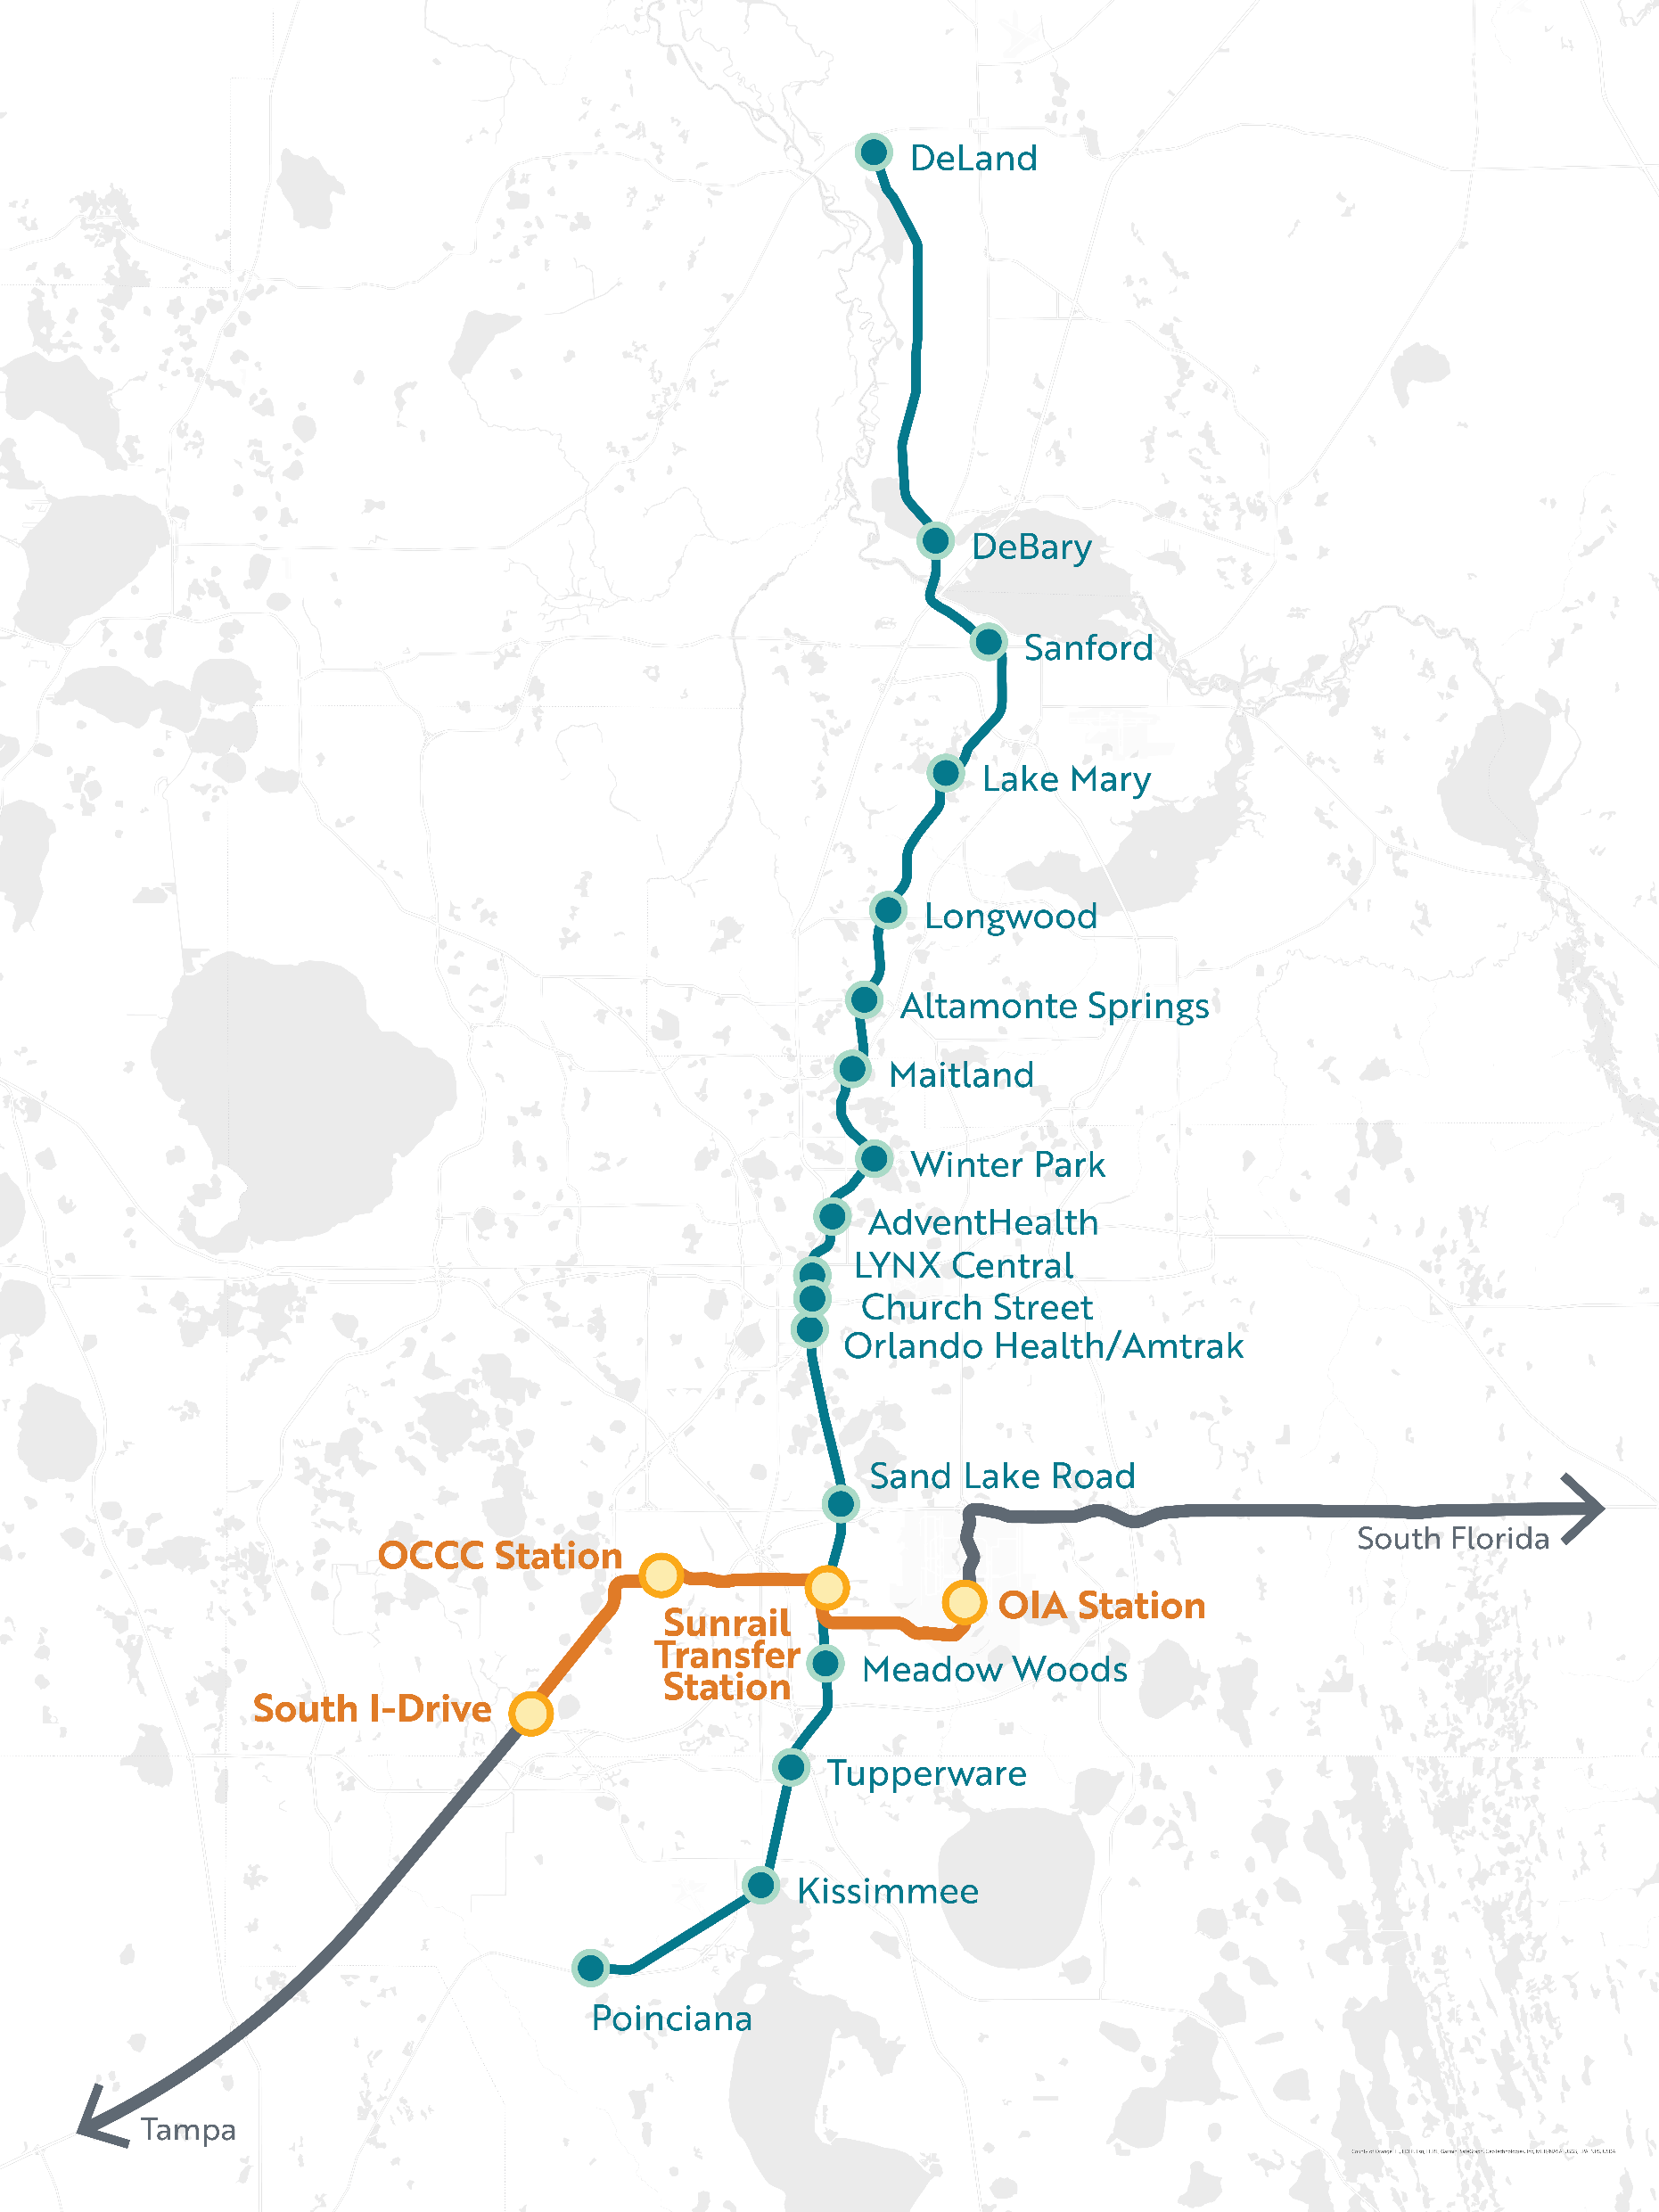
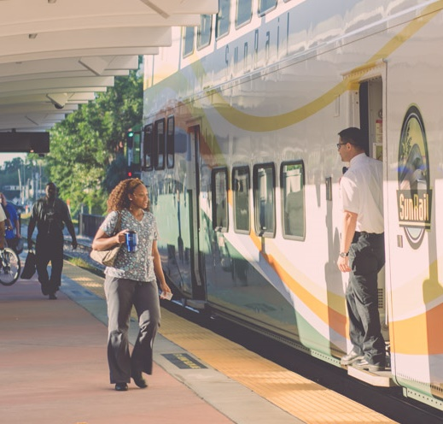
PROPOSED CONNECTIVITY

Slide 3

Sunshine Corridor
White Paper to FTA
JULY 28, 2022
FDOT
Orlando International Airport
7th busiest airport in the world
Over 22,000 badged employees
Orange County Convention Center
Over 1.5 million annual attendees
Over 75,000 employees within the Activity Center
Adjacent to future Universal Epic Theme Park
South International Drive
Over 55 million visitors annually
Over 53,000 employees
Adjacent to Walt Disney World

Slide 4
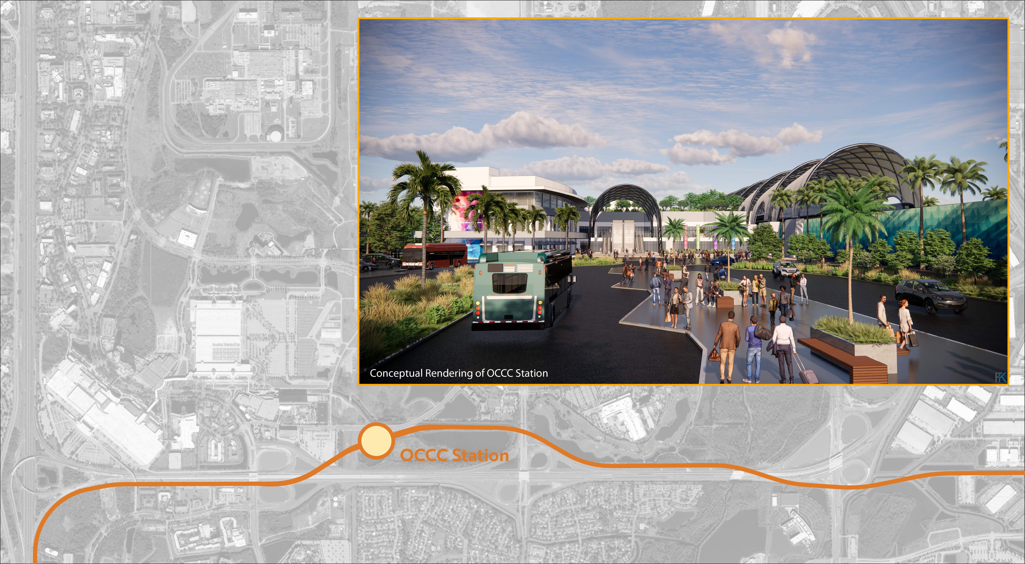
OCCC Multi-Modal Transit Station
Establishes a regional node for mobility integration and connectivity.
Provides a seamless end-to-end experience with multi-modal options for a wide diversity of regional mobility customers.
Leverages mobility planning to generate economic development, housing, and jobs.
Enables flexibility to integrate future mobility technologies.

Slide 5

ORLANDO’S RIGHT RAIL
Establish a dedicated public entity to support the development and operation of the Sunshine Corridor Plan, creating a SunRail connection between the airport and the convention center.
Based upon its investment in Epic Universe, Universal will support the dedicated entity’s financing of up to $125 million in private activity bonds to be used to fund the rail corridor and the Convention Center station.
Support the operation and maintenance of the station by the dedicated entity so there is no cost to Orange County taxpayers.
Universal will pledge 13 acres of land at no cost to be used for a convention center station with inter-modal capability and a substantial section of the rail corridor.
Universal and all the Orlando’s Right Rail partners will contribute to and collectively guarantee $13 million in annual ticket sales for the new Sunshine Corridor through the dedicated public entity. This amount is the current estimated operating cost for seven-day/365-day a year operation of this corridor.
PRIVATE
SECTOR
PARTNERSHIP

Slide 6
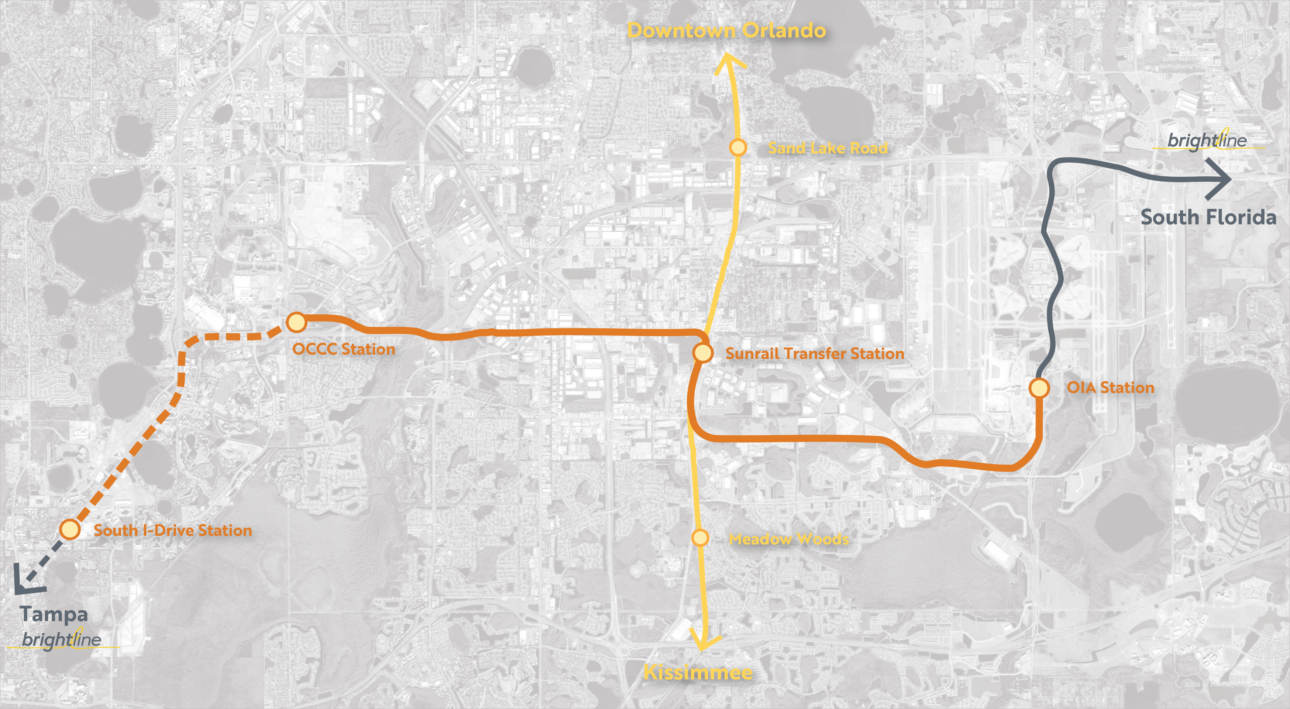

Slide 7
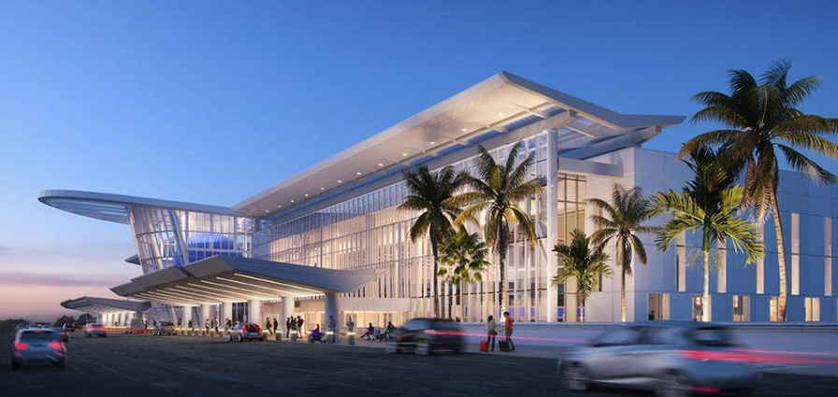
BRIGHTLINE
ORLANDO
TAMPA
WEST PALM BEACH
FORT LAUDERDALE
MIAMI
MIAMI TO ORLANDO

Slide 8
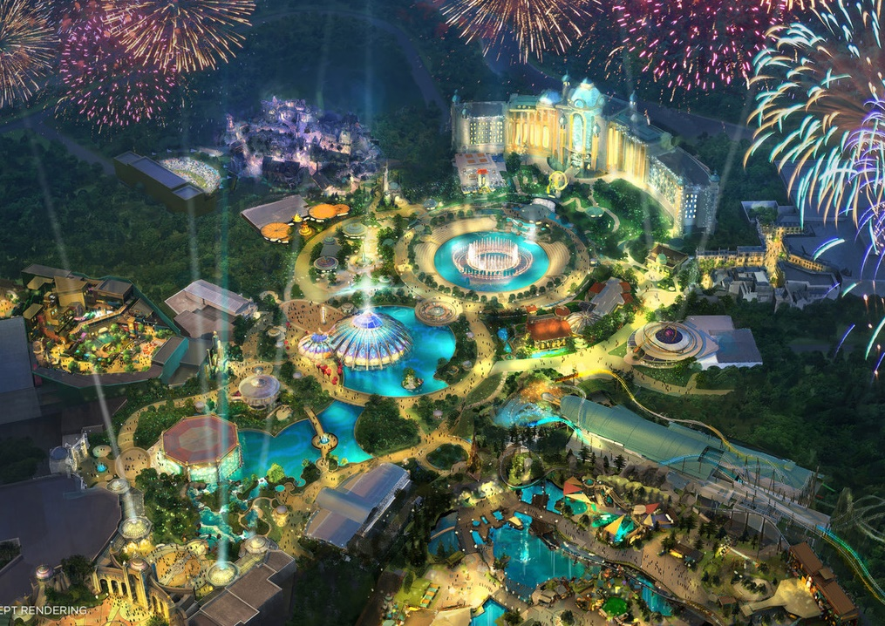

Notes:
Universal Orlando’s Epic Universe will be a world-class, game-changing theme park that will make Universal Orlando a week-long vacation destination.
Epic Universe will be technologically advanced with innovative lands and attractions featuring trip-driving IPs.
The park is being built on a 750-acre site – which will nearly double the current footprint here in Orlando.
Construction is on track to open in 2025… To date, we’ve used 20,000 tons of steel, constructed more than 85 buildings and laid 6,500 miles of cable at the site.
We plan to hire thousands of team members for Epic Universe
It represents Comcast/NBCUniversal’s single-largest investment in the state of Florida
We’re also heavily investing in transportation improvements with the Kirkman Road extension – a project that will directly benefit residents and tourists by the end of 2024.

Slide 9
Questions

